Slide 1
2012 HWRF upgrades
EMC HWRF team

Slide 2
Features of the 2012 HWRF upgrades
For the first time, a high-resolution hurricane model (27-9-3km HWRF) is being implemented into NCEP operational system
This upgrade is a result of multi-agency efforts under HFIP support
- EMC: Computational tuning to speed up the model, nest motion algorithm, physics improvements, 3km initialization and pre-implementation T&E
- HRD/AOML: multi-moving nest, nest motion algorithm, PBL upgrades, interpolation routines for initialization and others.
- DTC: code management and maintain subversion repository
- ESRL: Physics sensitivity tests and idealized capability
- NHC: Diagnose the HWRF implementation results
- URI: 1D ocean coupling in Eastern Pacific basin

Slide 3
Features of the 2012 HWRF upgrades (contd.)
Jet machine is used heavily for the pre-implementation tests thanks to the HFIP management. Consistently used about 5000 cores for the past one month. Because of the limitations of CCS resources, each component of upgrades was tested in Jet machine.
The structures of storms improve significantly in H212 in addition to the track and intensity improvement, such as PBL height, storm size, wind-pressure relationship and initial spin-up/spin-down.

Slide 4
2012 HWRF Upgrades
Initialization
- Build the vortex initialization at 3km resolution instead of downward interpolation of 9km initialized field to 3km domain.
2. Dynamics
- modified several components of the model codes to speed up model run time in order to fit the operational time window.
- Add I/O server – remove the standard output
- Time step of model integration 45, 15, 5 sec
- Fix a bug in mask inside the leading edge of a nest domain
3. Add one dimensional ocean coupling in Eastern Pacific basin with help of URI.

Slide 5
2012 Upgrades (contd.)
4. Physics
- Add GFS shallow convection scheme with slight tuning (no precip. from SC when cloud is less than 50mbs thick and SC top is below PBL top)
- Modify several microphysical parameters to more realistic values (NLImax, NCW and snow fall speed)
- PBL: Change critical Richardson number from 0.5 to 0.25, and alpha=0.5 from 1
- Use the constant Ch profile with wind speed consistent to the observation
5. Tune GSI
- Upgrade GSI to version 3.5 which is the latest community version. Optimize the impact of prepbufr data in a storm environment.

Slide 6
Verification stats for
2011 season

Slide 7
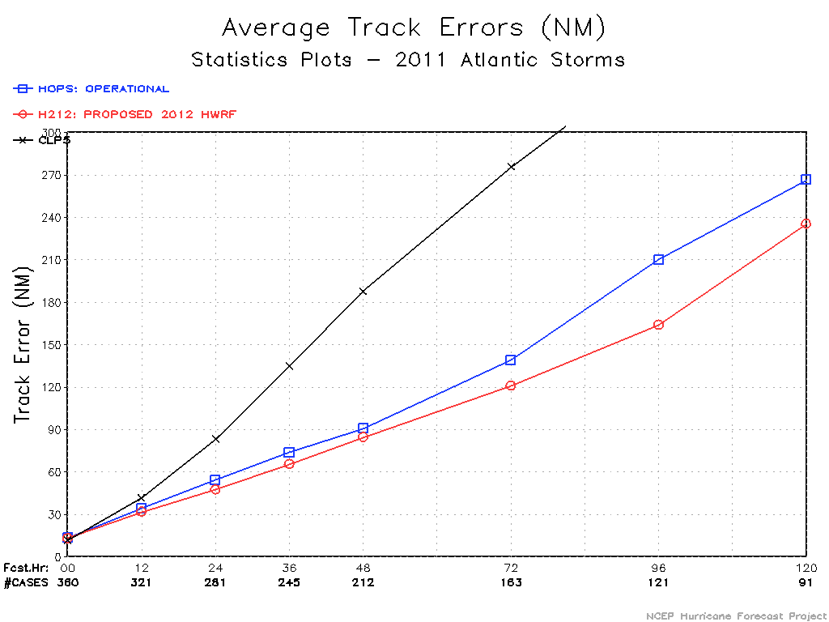
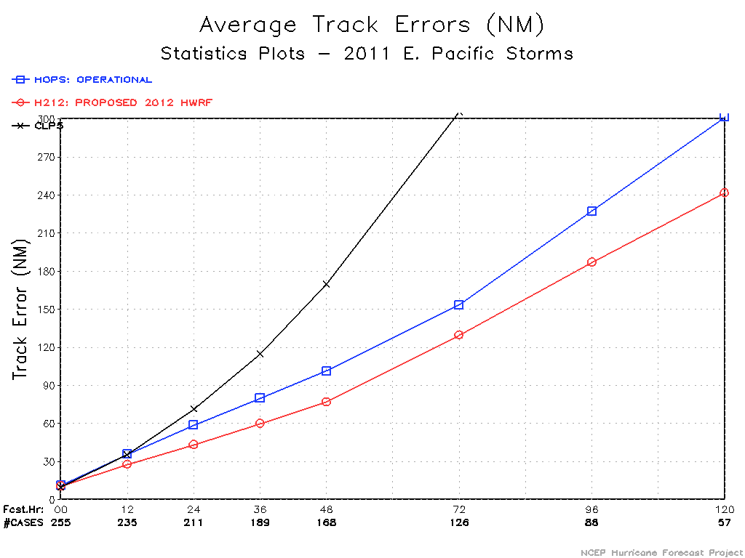
Track error
ATL
EP
HOPS: operational HWRF
H212: 2012 HWRF
Maximum 20% improvement
Maximum 25% improvement

Slide 8
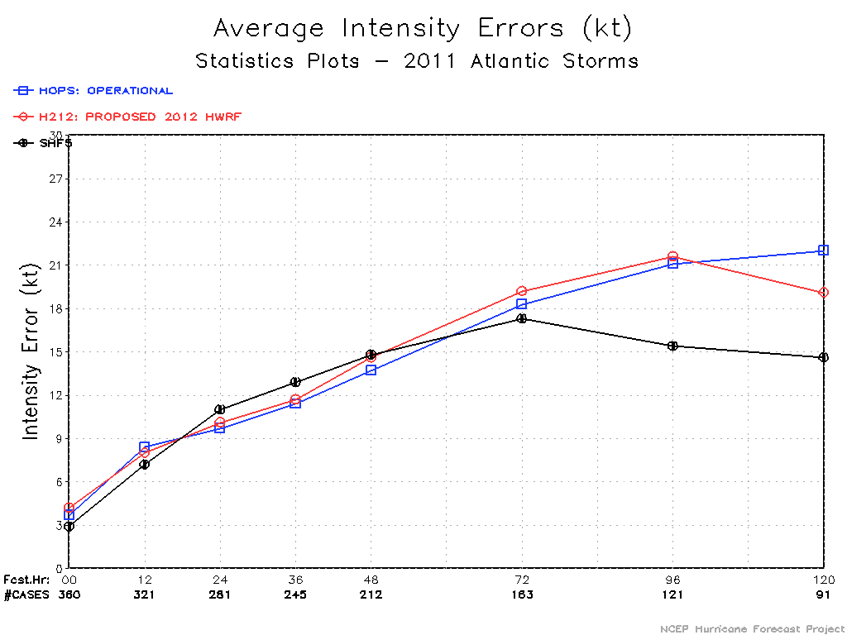
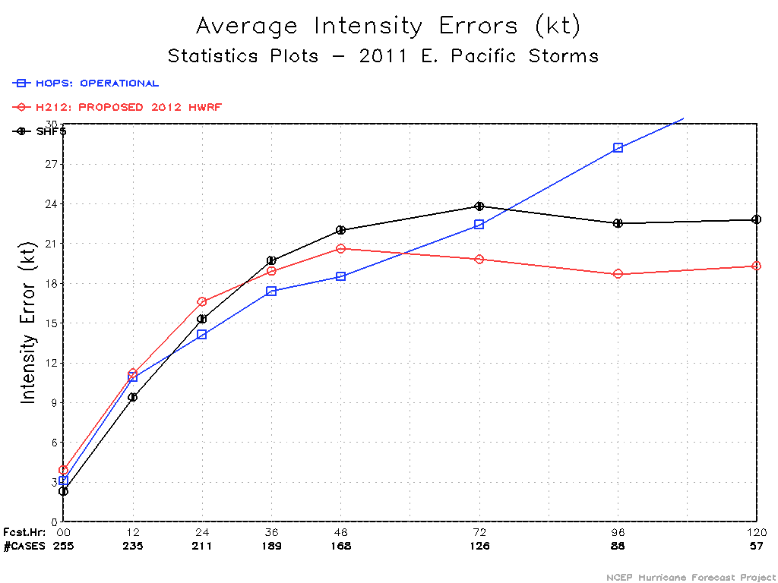
Intensity error
ATL
EP
Comparable except day 5
Maximum 40% improvement at day 5
But degradation at day 1 and 2

Slide 9
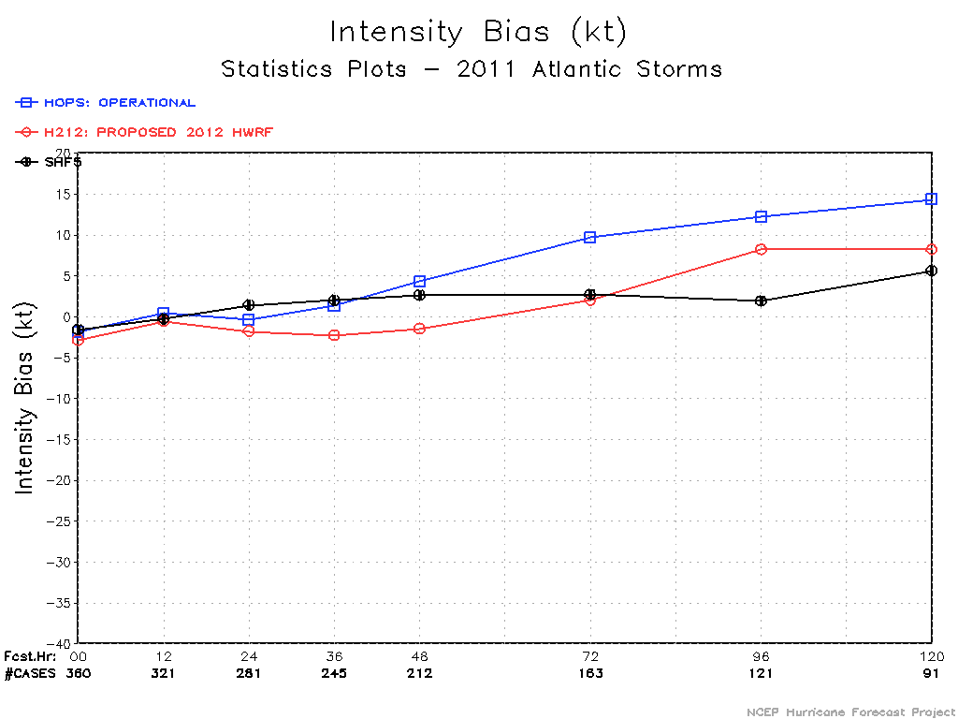
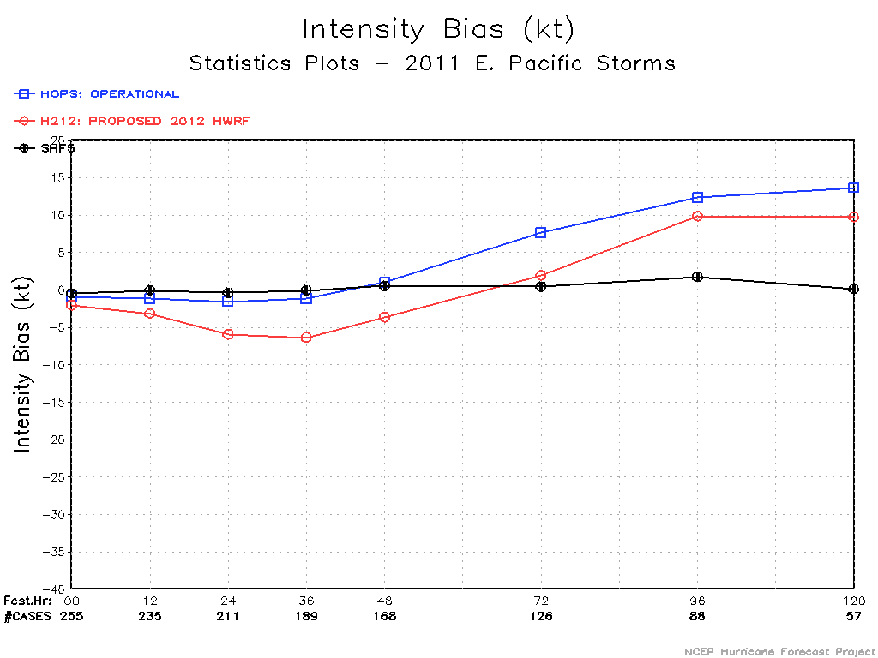
Intensity bias
ATL
EP

Slide 10
Verification stats for
2010 season
The results are from Jet machine. CCS runs are going on.

Slide 11
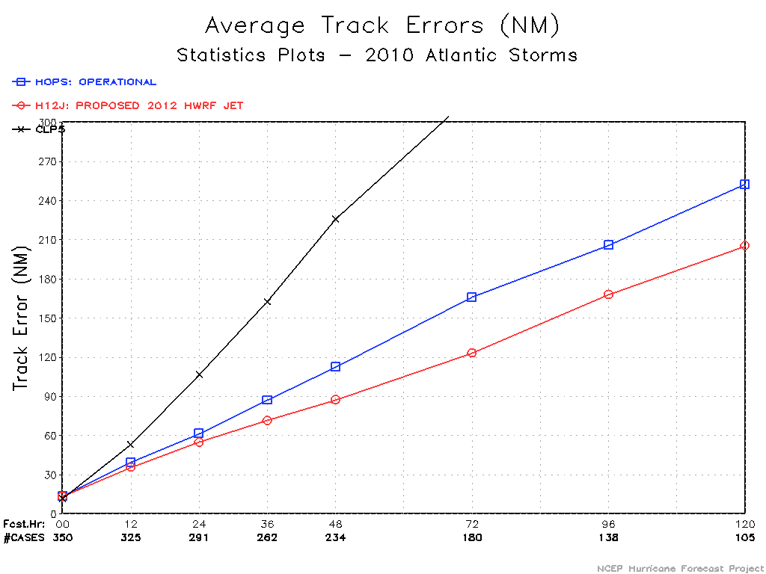
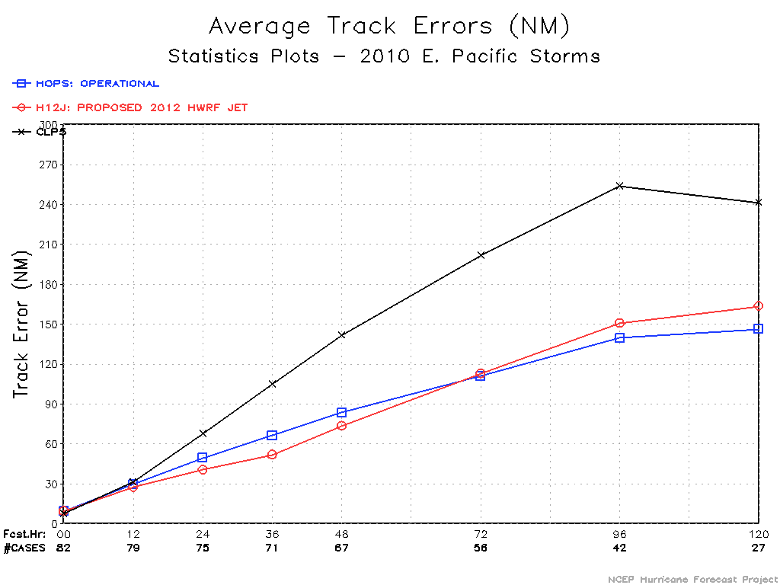
Track error
ATL
EP
Degradation mainly from Frank
Maximum 25% improvement
Comparable

Slide 12
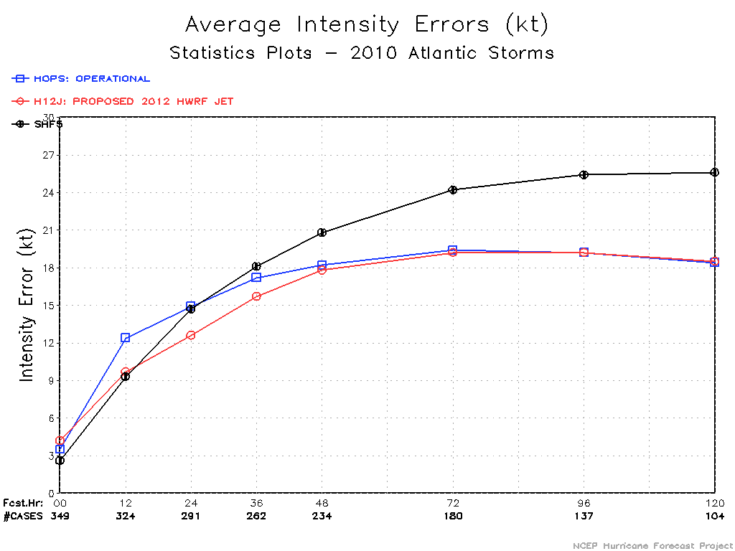
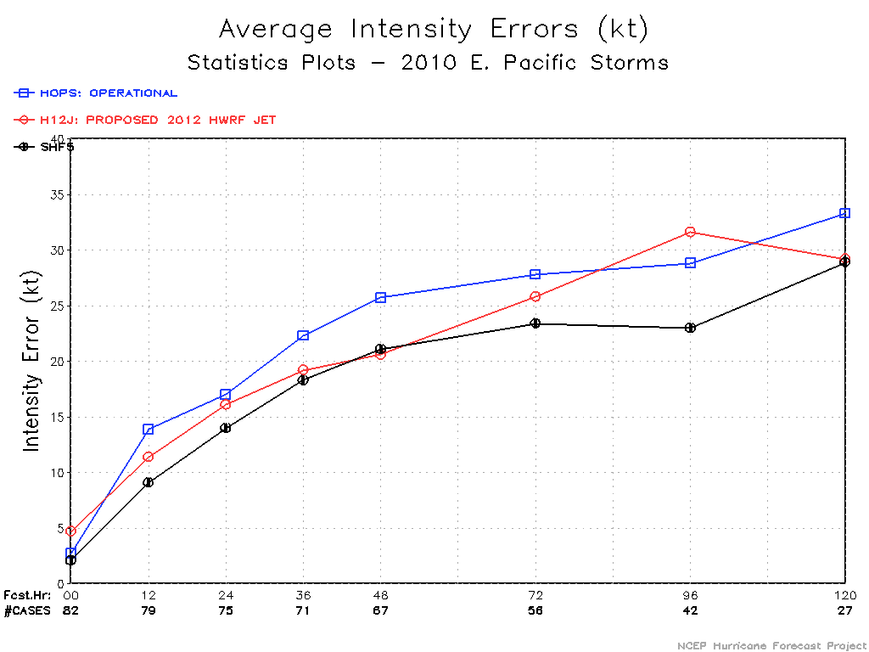
Intensity error
ATL
EP
Maximum 15% improvement at early time
Maximum 20% improvement

Slide 13
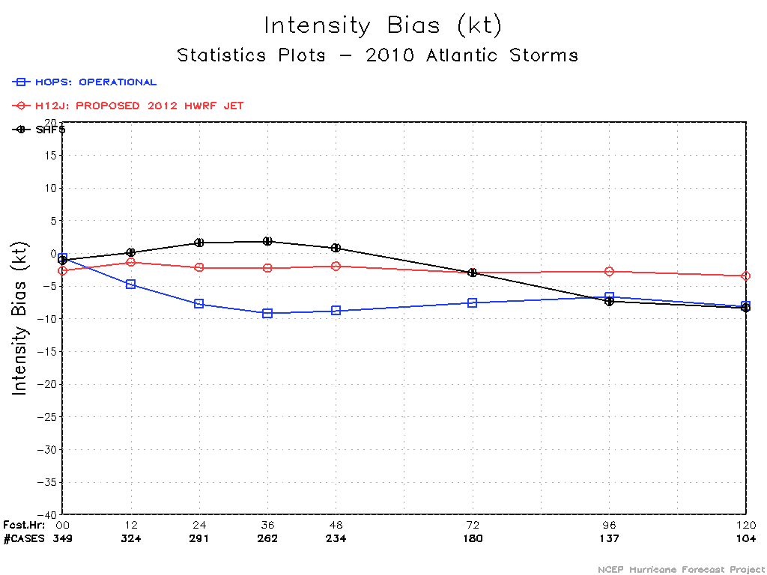
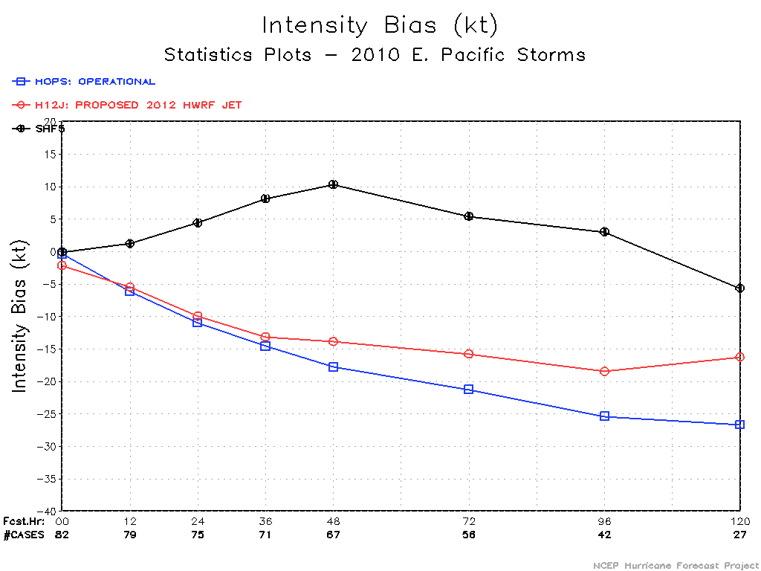
Intensity bias
ATL
EP

Slide 14
Verification of storm structures
Storm size
PBL height
Wind-pressure relationship
Initial spin-up/spin-down

Slide 15
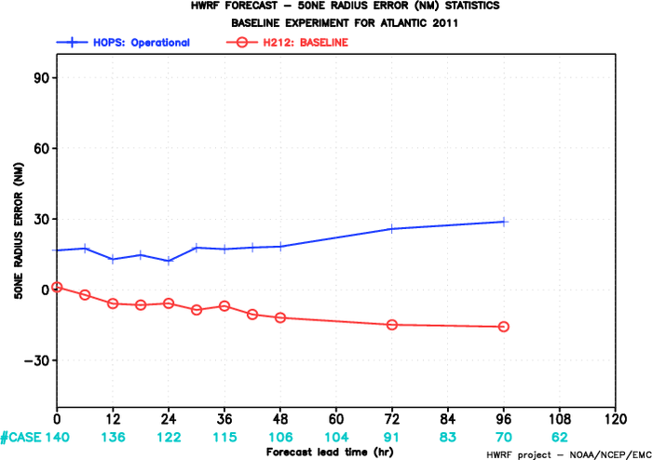
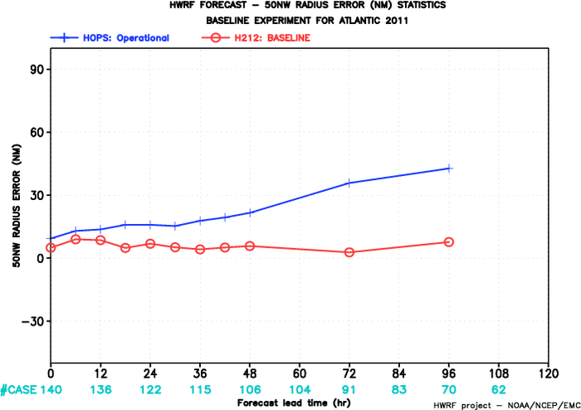
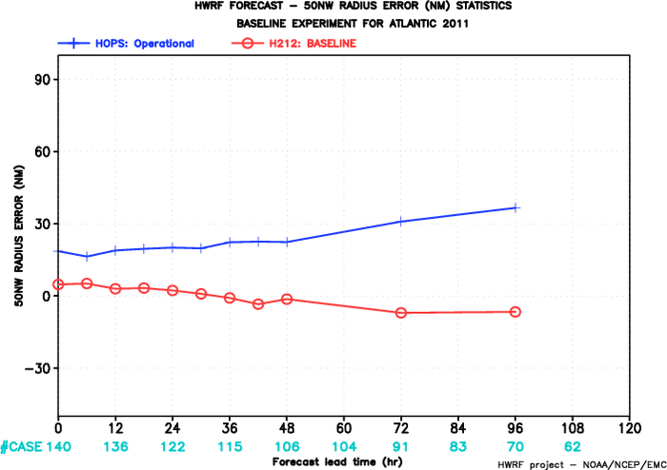
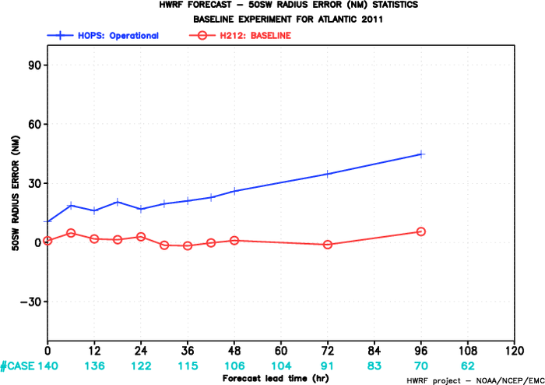
50kts Radius error 2011 Atl storms
NE
NW
HOPS: operational HWRF
H212: 2012 HWRF
SE
SW

Slide 16
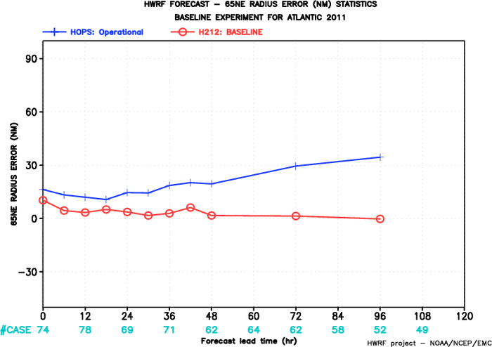
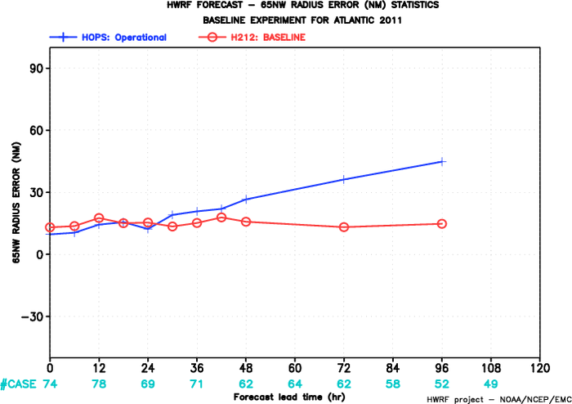


65kts Radius error 2011 Atl storms
NE
NW
SE
SW

Slide 17
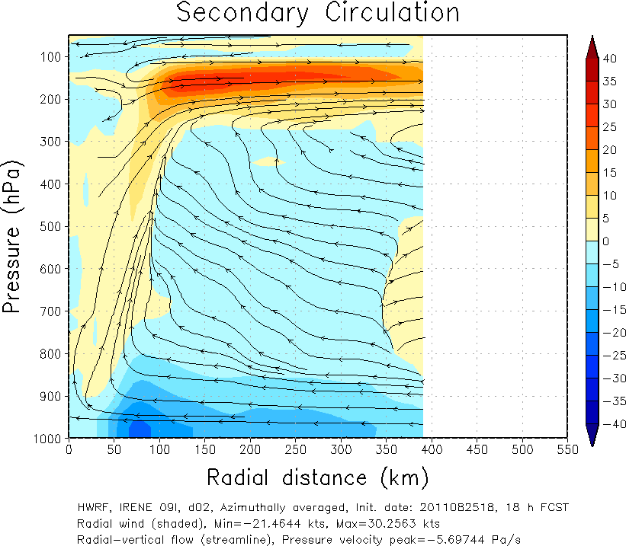
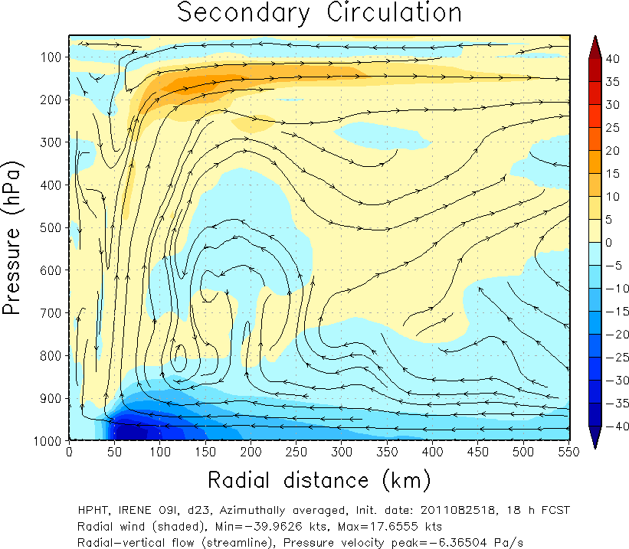
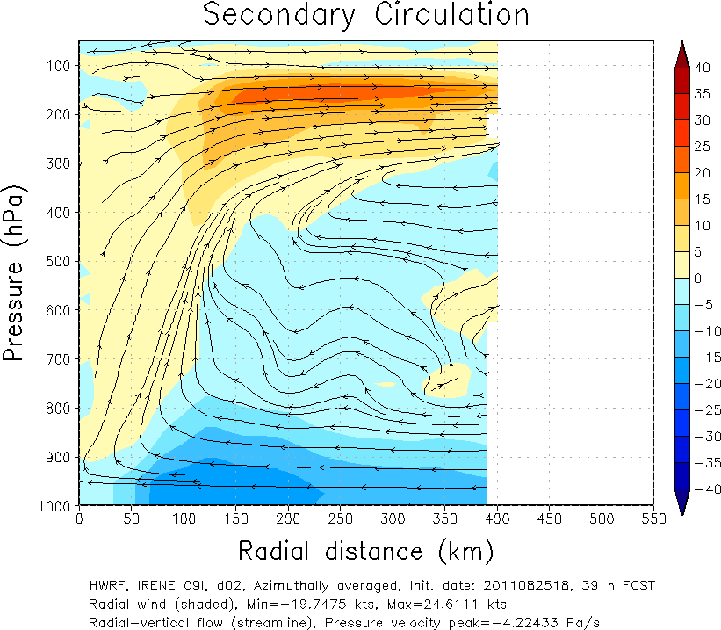
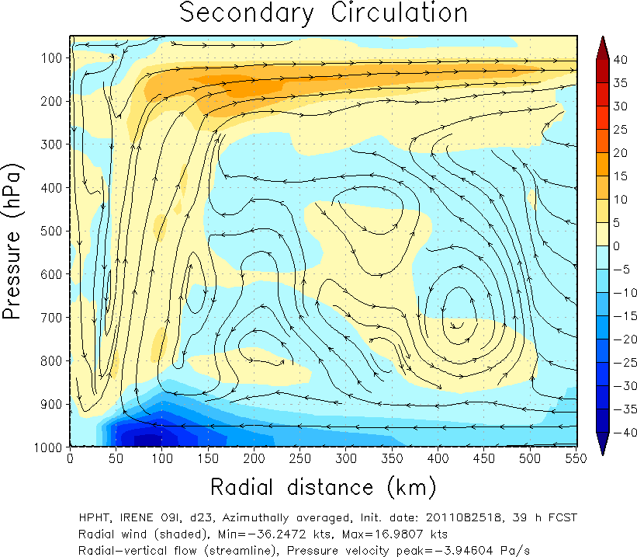
PBL height comparison: Irene 2011082518
HOPS
H212
PBL is shallower in H212 than HOPS

Slide 18
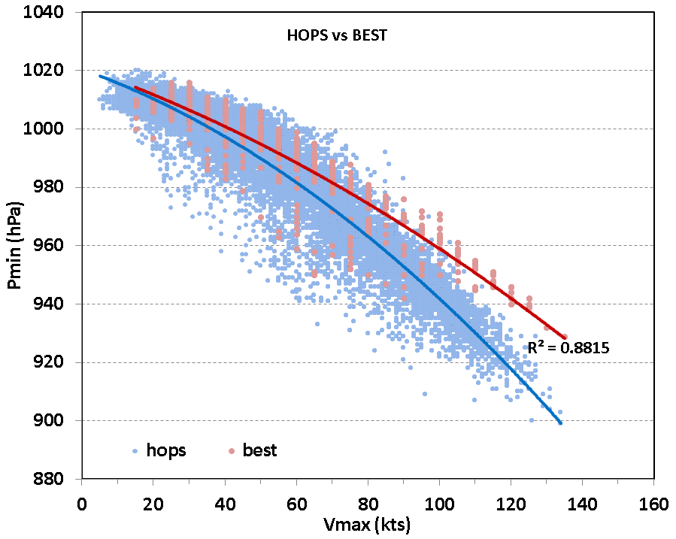
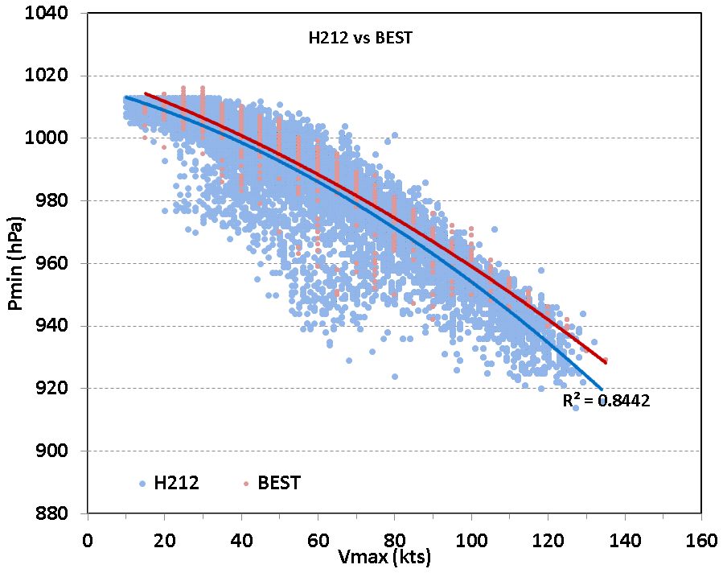
Wind – Pressure relationship
Operational HWRF
2012 HWRF
Best track
Model output

Slide 19
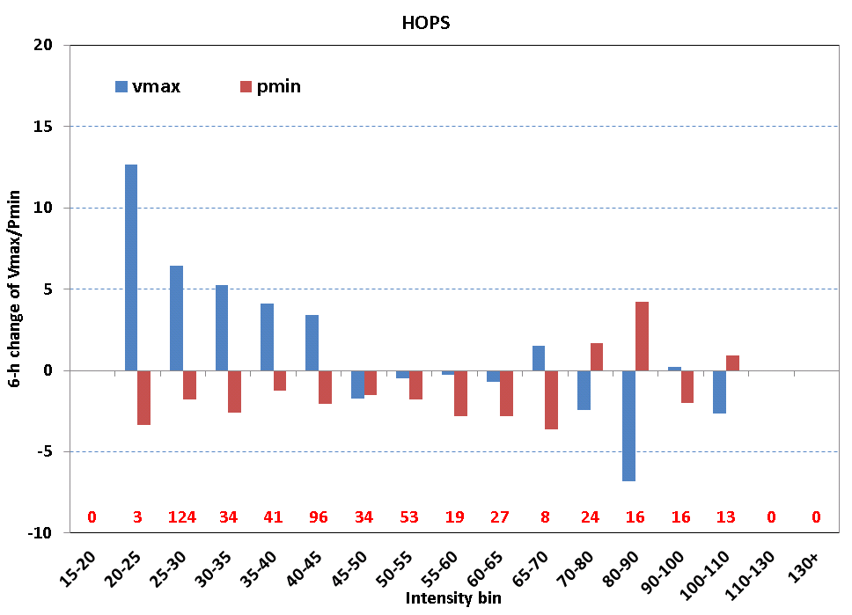
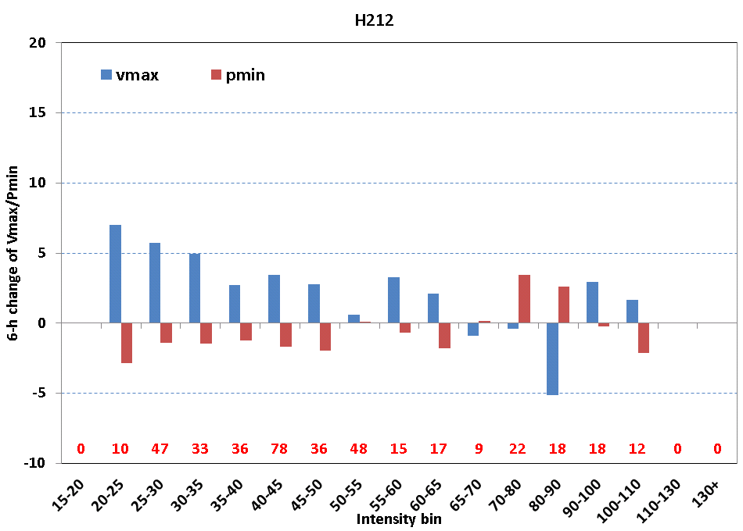
Initial 6hr spin-up spin-down
Operational HWRF
2012 HWRF

Slide 20
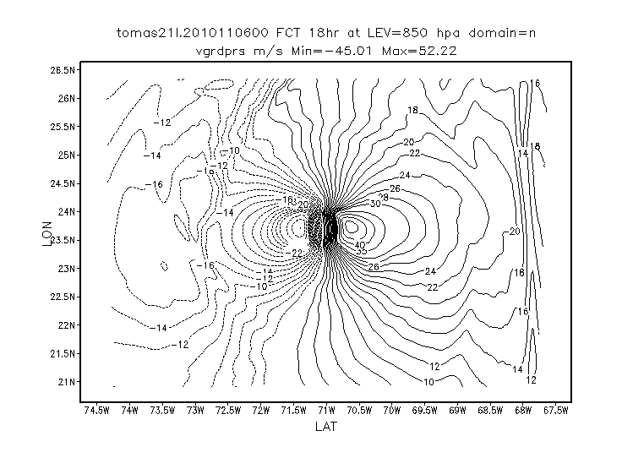
A bug which causes the discontinuity in the lateral boundary (esp. east)
Hurricane Tomas 2010.11.06.00UTC (+18hr)

Slide 21
Found a bug related to the nest motion(mask setting over the leading edge) caused the discontinuity. After fixing the bug, the discontinuity is gone.

Slide 22
Individual storm

Slide 23
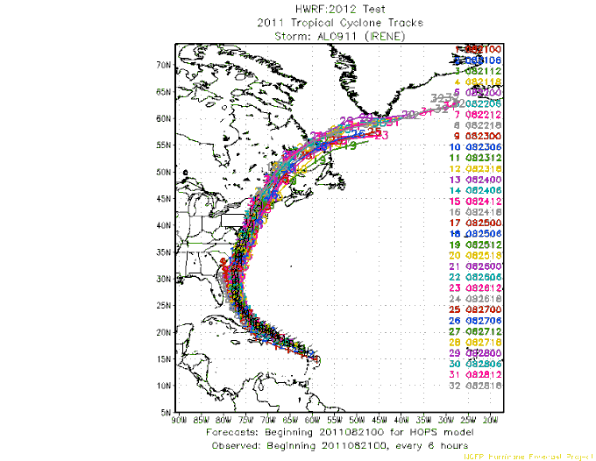
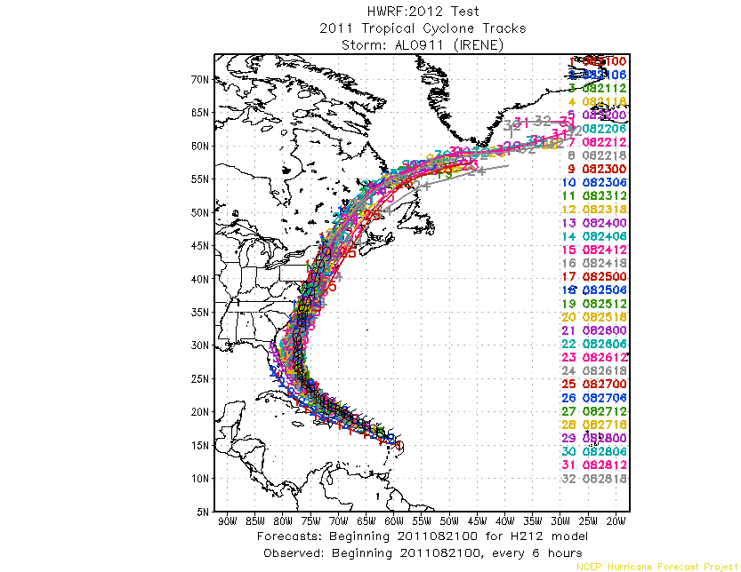
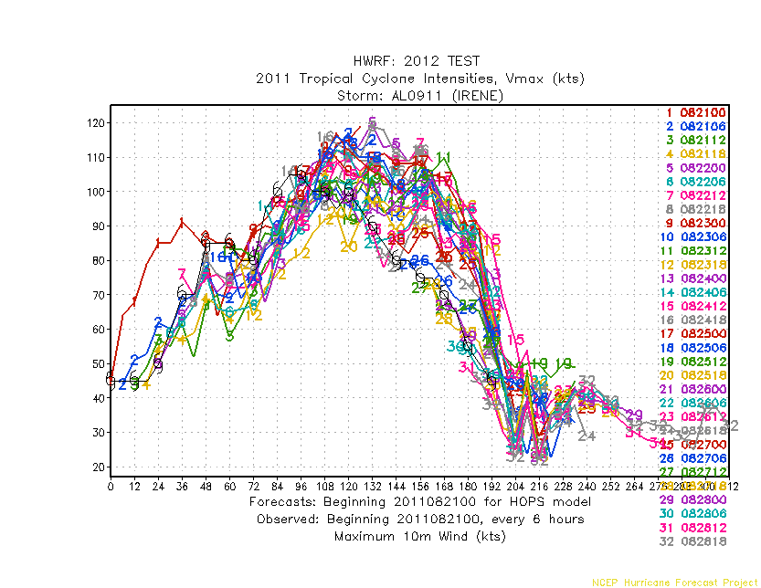
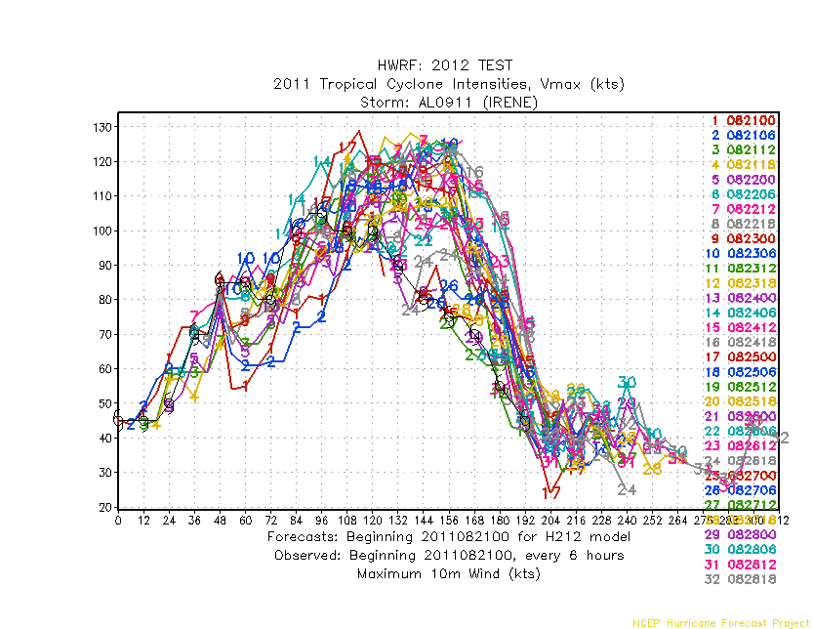
IRENE 09L 2011
HOPS
H212

Slide 24
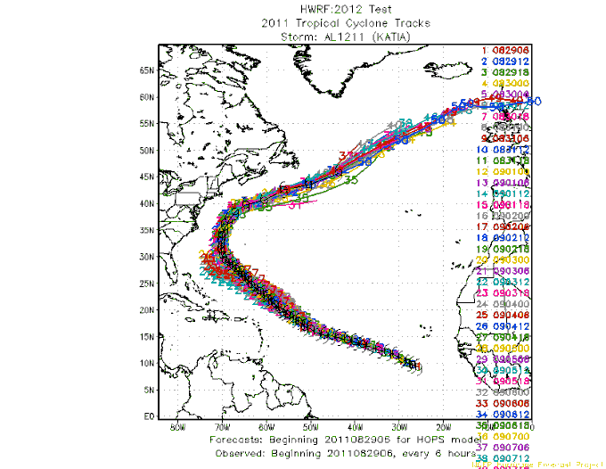
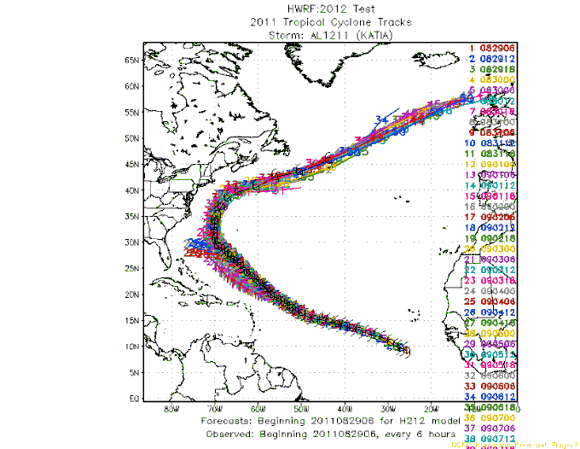
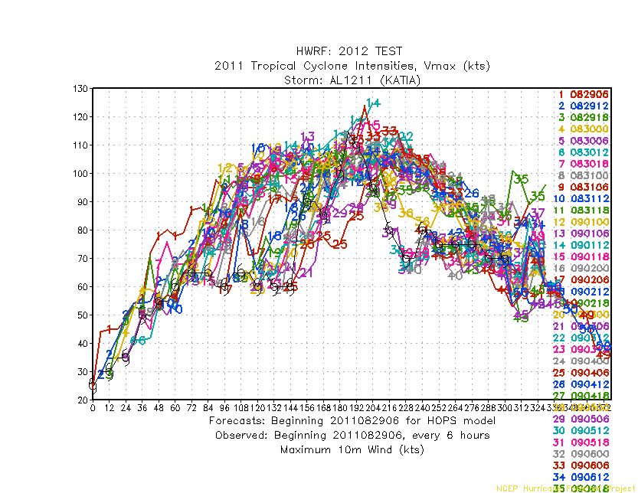
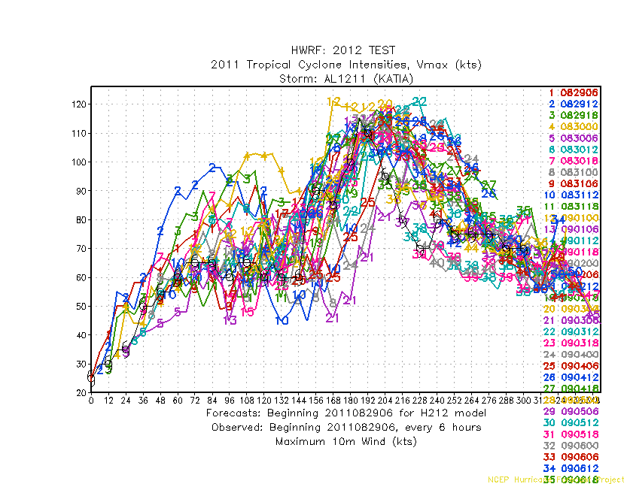
KATIA 12L 2011
HOPS
H212

Slide 25
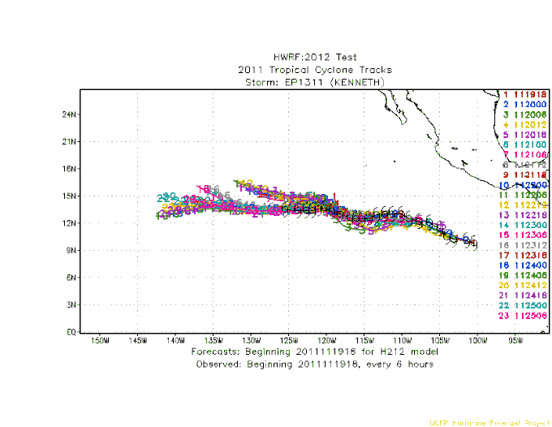
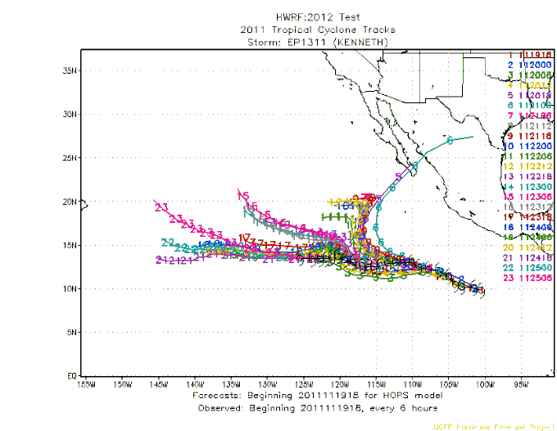
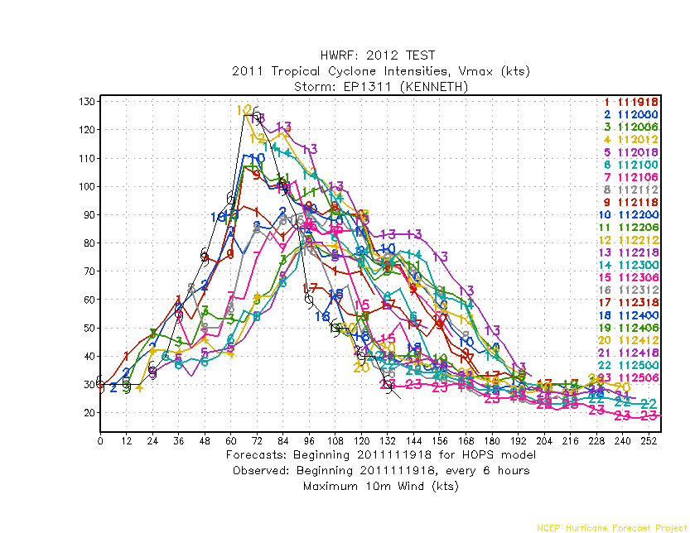
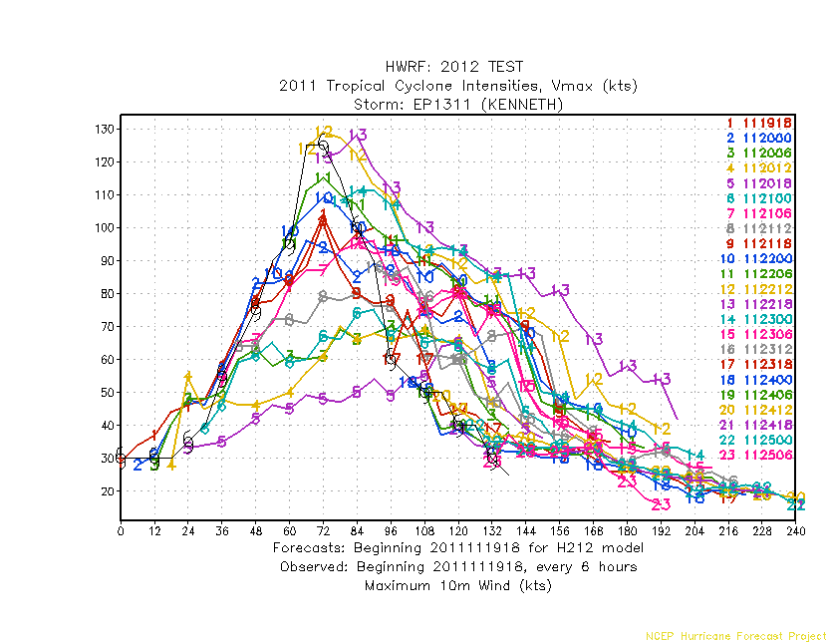
KENNETH 13E 2011
H212
HOPS

Slide 26
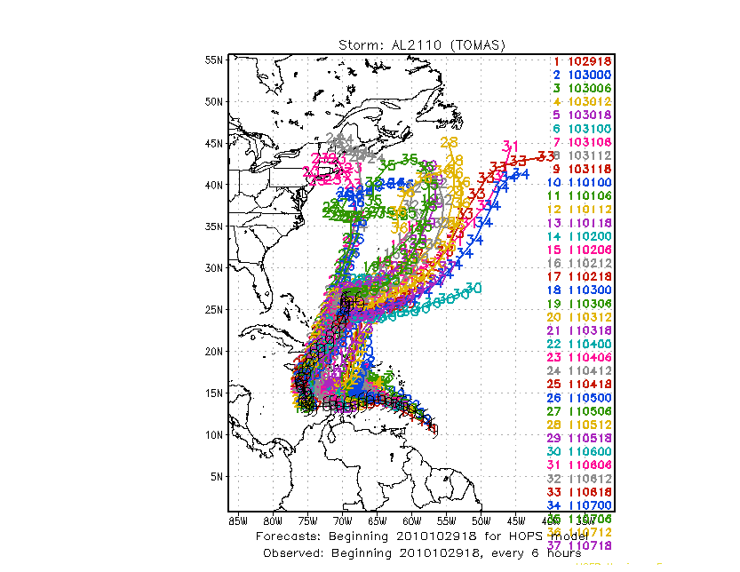
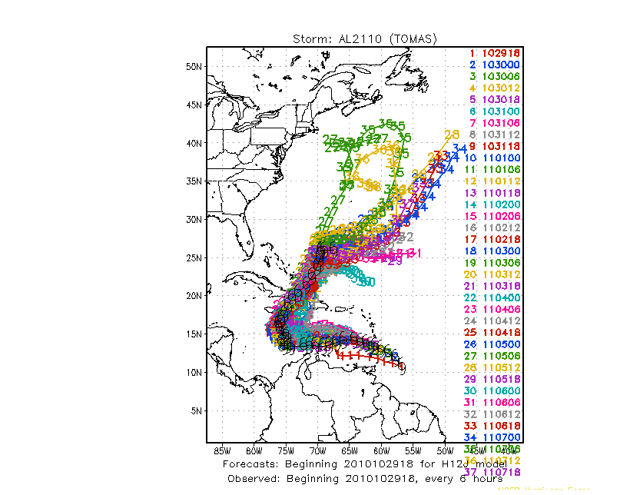
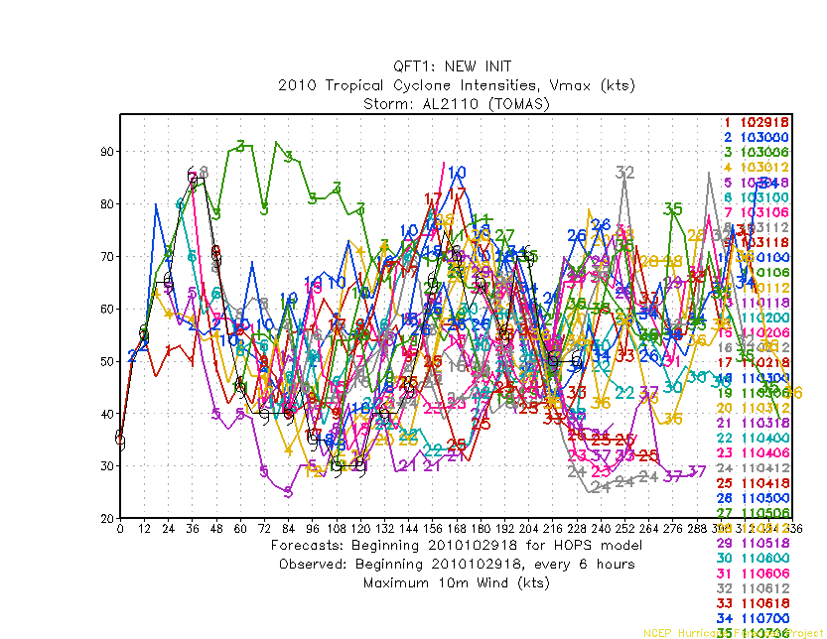
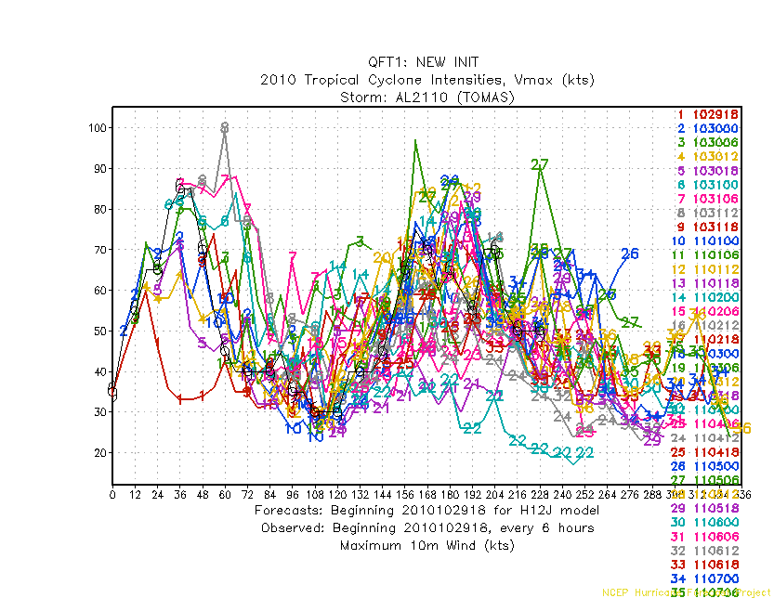
TOMAS 21L 2010
HOPS
H212

Slide 27
Summary
Track forecast skills of H212 improved significantly over both 2011/2010 seasons on Atlantic basin with about 20-25% improvement against HOPS
Track forecast skills of H212 of Eastern Pacific basin also improved maximum 25% over the HOPS in 2011 season, but little degradation at day 4 and 5 in 2010 season mainly due to Hurricane Frank
Intensity forecast improvement is not as impressive as track improvement, but show overall improvement. The biggest improvement of intensity is 2011 EP basin with over 40% to HOPS. However, significant improvements in intensity bias is noted for both Atlantic and Eastern Pacific, for both 2010-2011 seasons.
On top of track and intensity skill, the storm structure of H212 improve as well, in terms of storm size and PBL height
The problem of wind-pressure relationship in high wind speed regime also significantly improved in H212

